Slide 1
[Secret Project] detailed_design.pptx
This file is one of Govdocs (http://digitalcorpora.org/corpora/govdocs)
The first page is added by NIST CFReDS project.
All following pages have no connection with to the scenario.

Slide 2

SynCAMs: From Synaptic Adhesion
to Synapse Formation
Thomas Biederer
Department of Molecular Biophysics and Biochemistry
Yale University

Slide 3
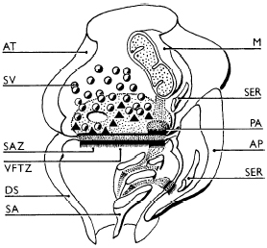
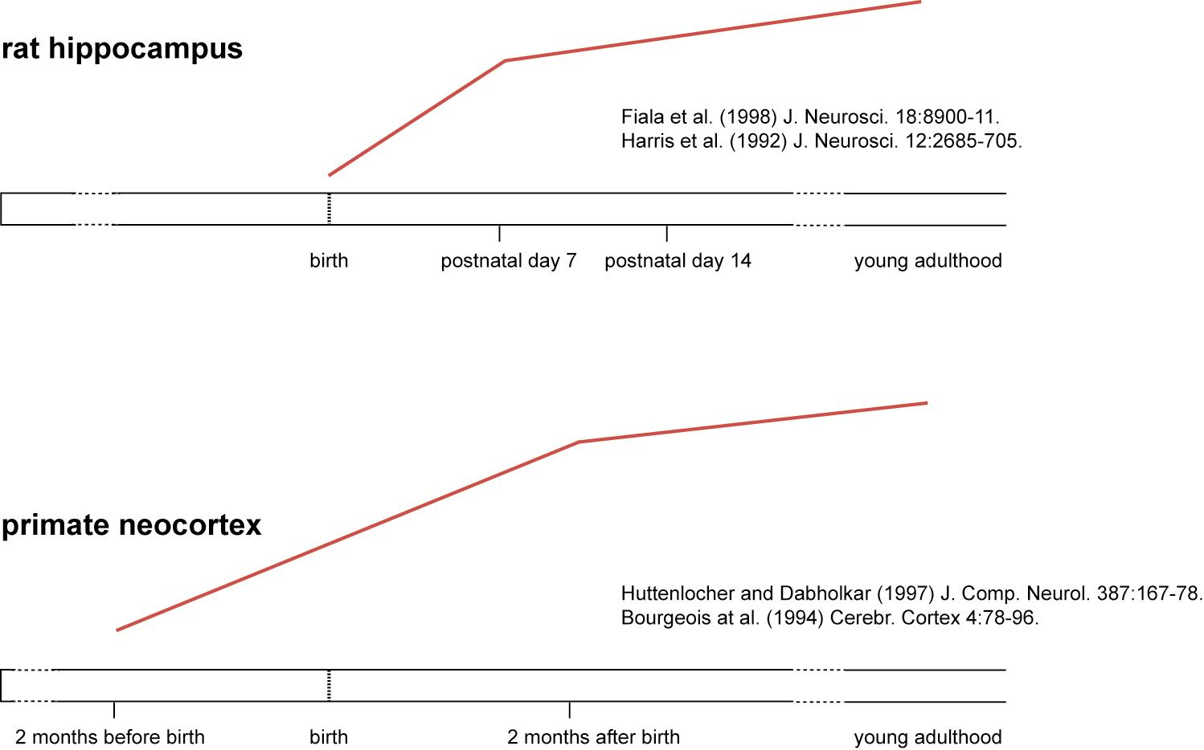
Synaptogenesis is Key to the Developing Brain
Spacek and Harris (1998)
J Comp Neurol. 393:58-68.

Slide 4
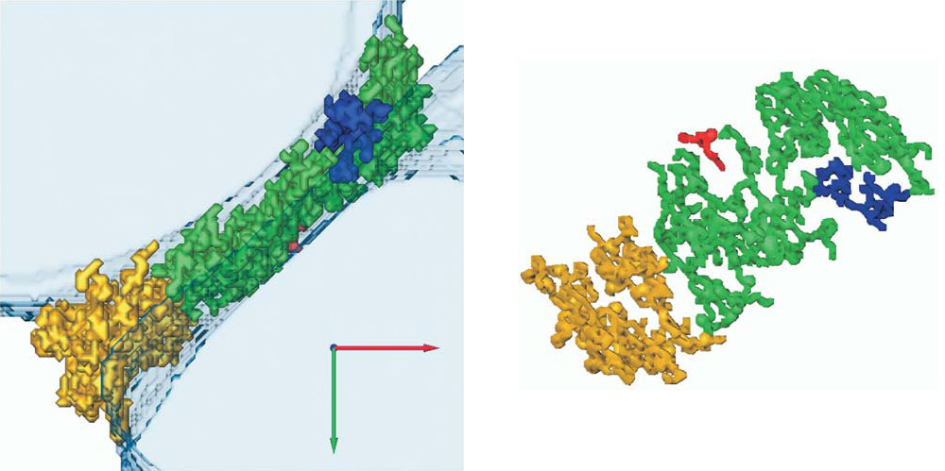
Molecular Complexes of the Synaptic Cleft
Lucic et al. (2005) Structure 13:423-34.
● extensive connections along the cleft form a highly connected structure
● dimensions of pre- and postsynaptic specialization are tightly correlated
● width of synaptic cleft is even

Slide 5
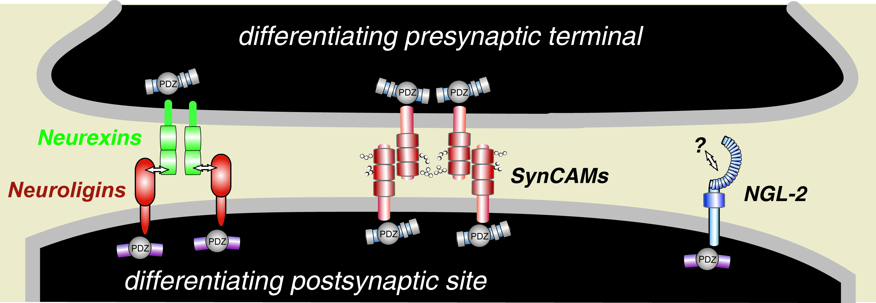
Adhesion Systems at the Developing Synaptic Cleft

Slide 6
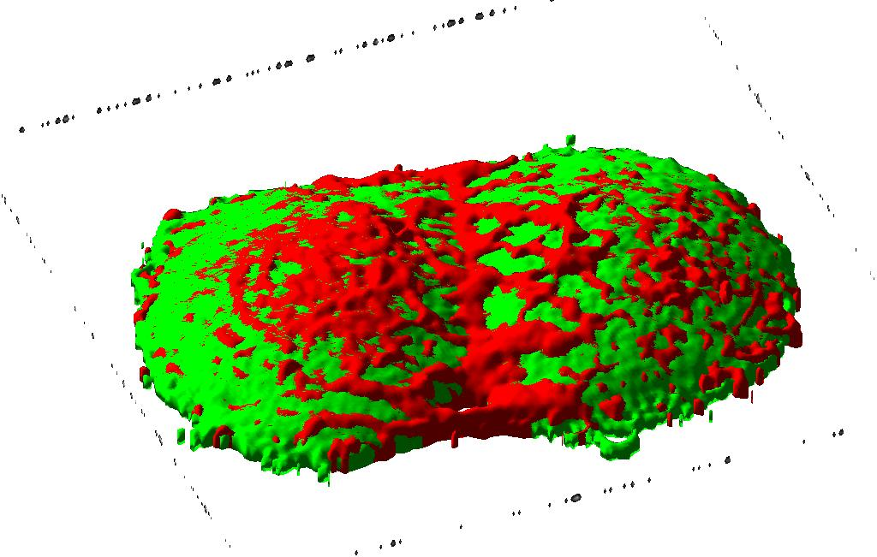
SynCAM 1 Mediates Homophilic Adhesion
heterologous expression of SynCAM 1 in COS cells
red: SynCAM 1-cherry
green: soluble GFP
Massimiliano Stagi

Slide 7
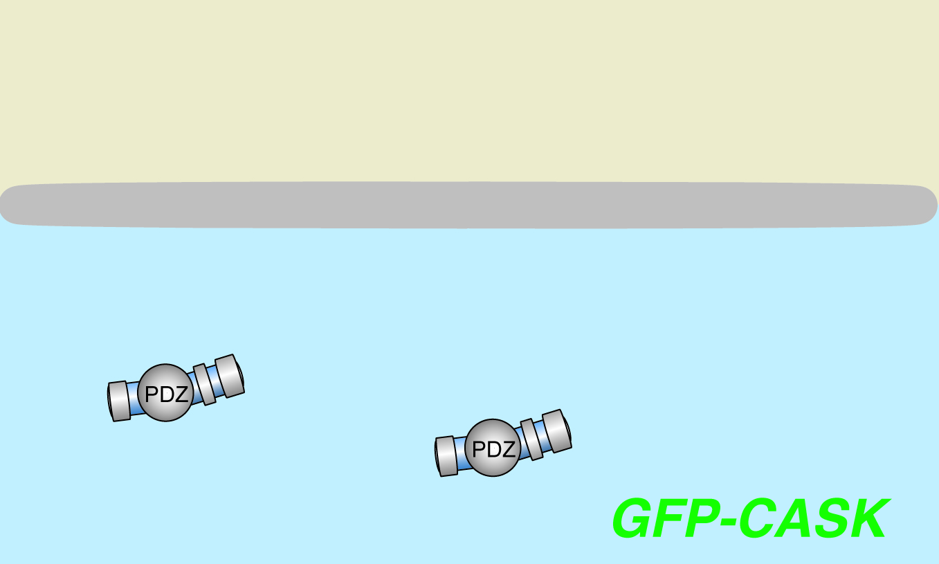
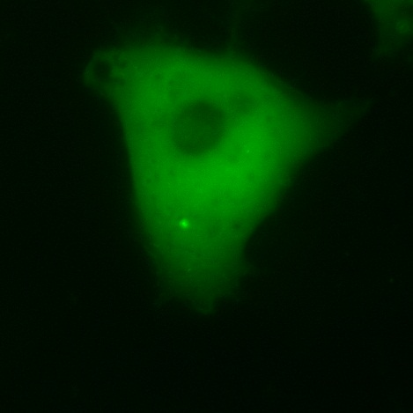
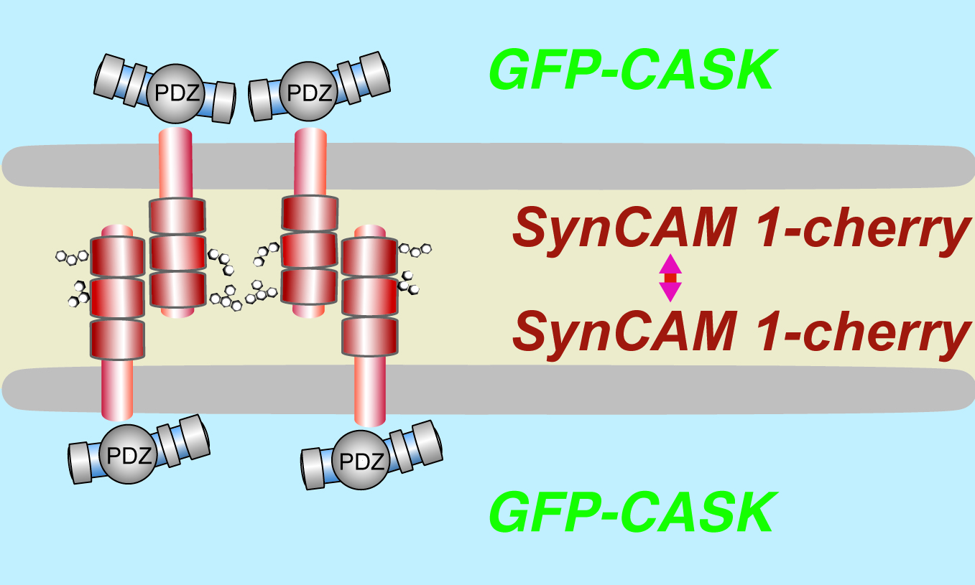
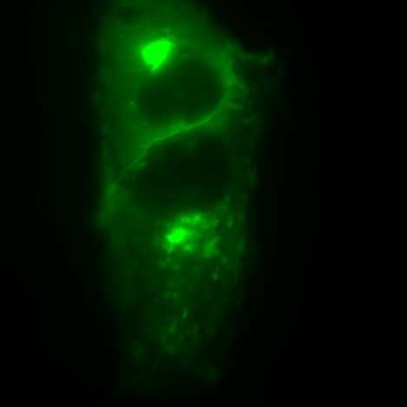
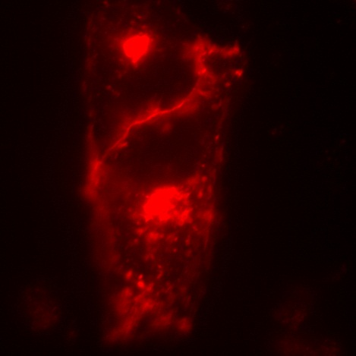
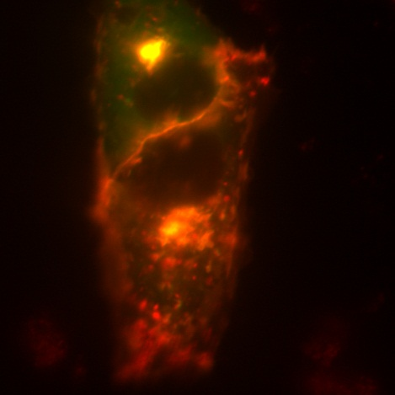
SynCAM 1 Recruits Scaffolding Molecules to Sites of Homophilic Adhesion
heterologous expression in COS cells
green:
GFP-CASK
green:
GFP-CASK
red:
SynCAM 1-cherry
overlay
Massimiliano Stagi

Slide 8
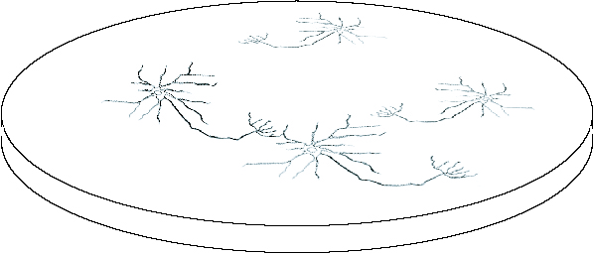
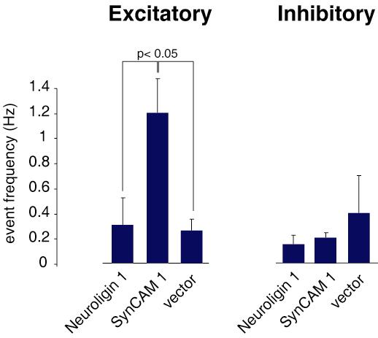
SynCAM 1 Potentiates Excitatory Transmission in Hippocampal Neurons
Yildirim Sara and Ege Kavalali

Slide 9
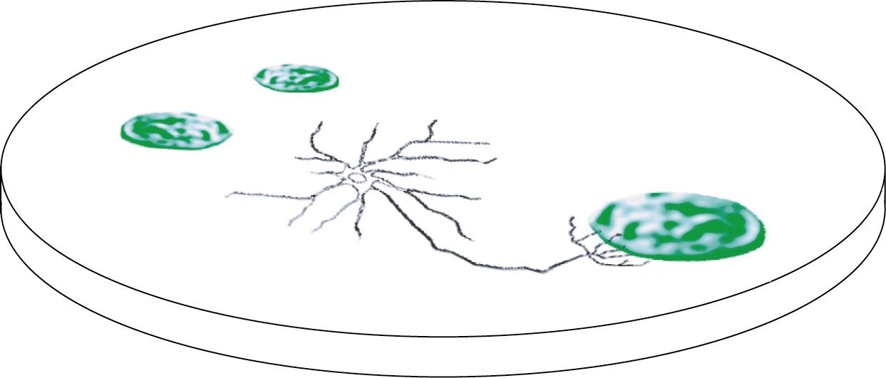
Induction of Synaptic Specializations in Co-Cultures
epithelial-like HEK293
cells expressing both
SynCAM 1 and ECFP
are seeded atop
hippocampal neurons
after 1-2 days in vitro,
the co-cultures are analyzed for the formation of specializations containing presynaptic markers on the surface of the HEK293 cells

Slide 10
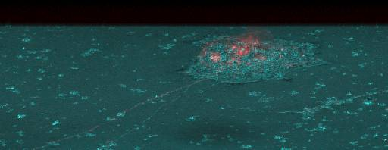
SynCAM 1 Induces Presynaptic Specializations
red synaptophysin

Slide 11
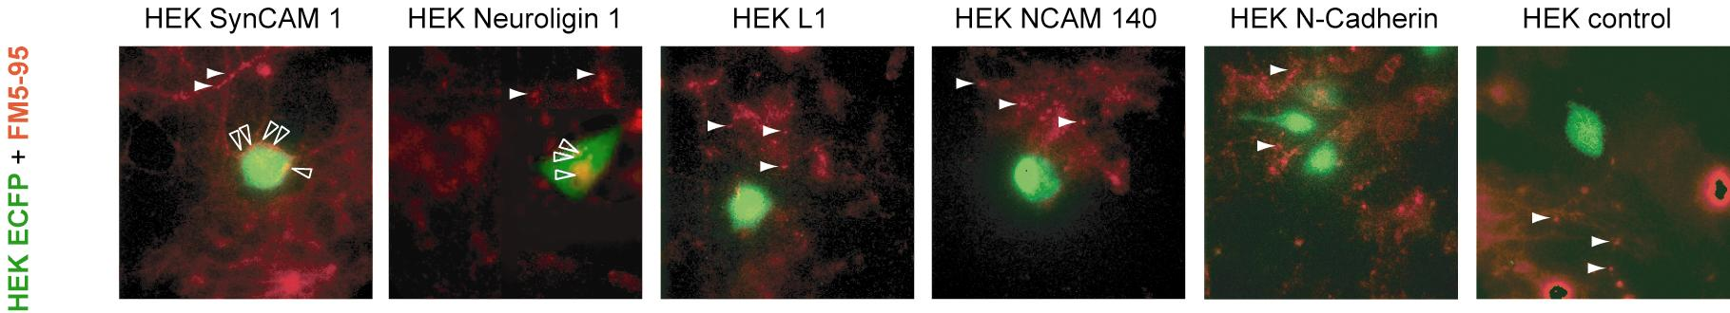
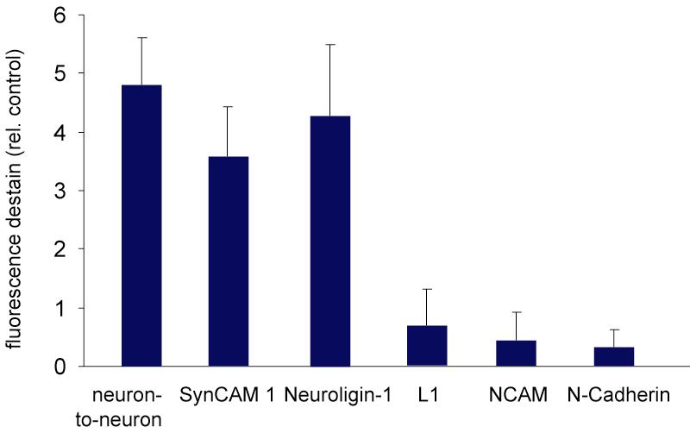
SynCAM 1 and Neuroligin Induce Presynaptic Terminals with Functional SV Recycling

Slide 12
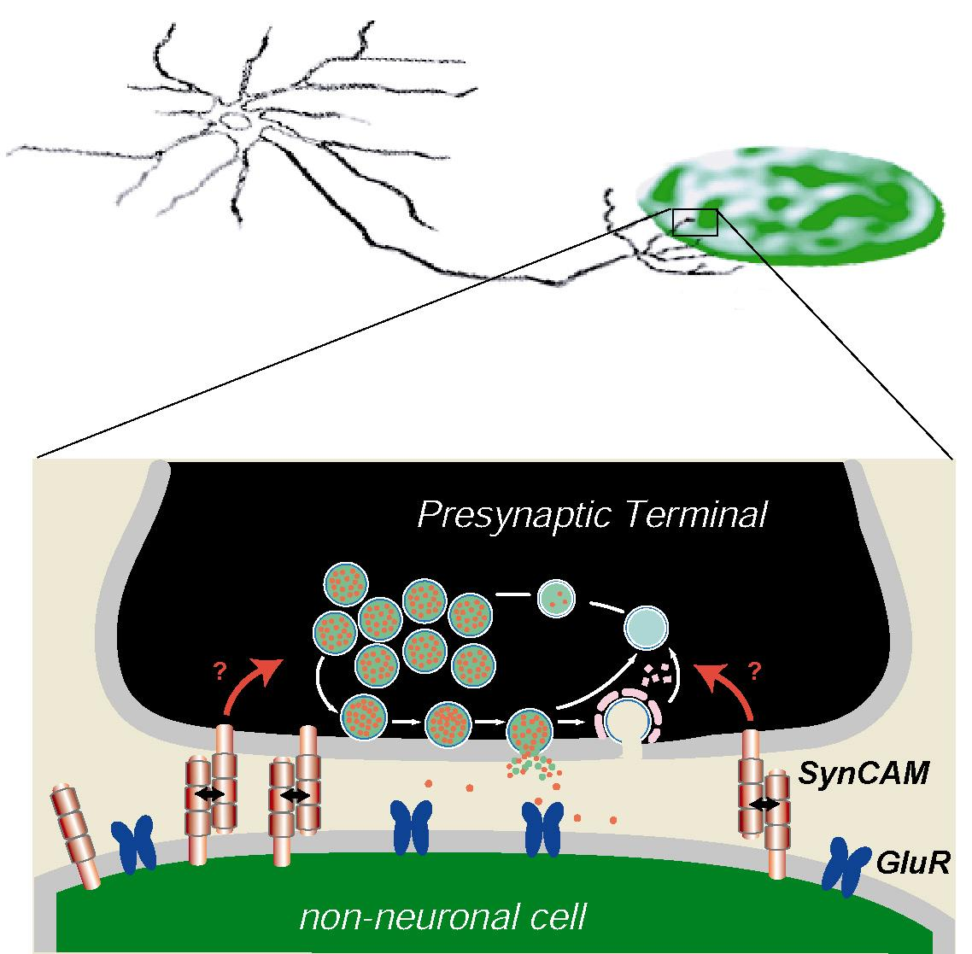
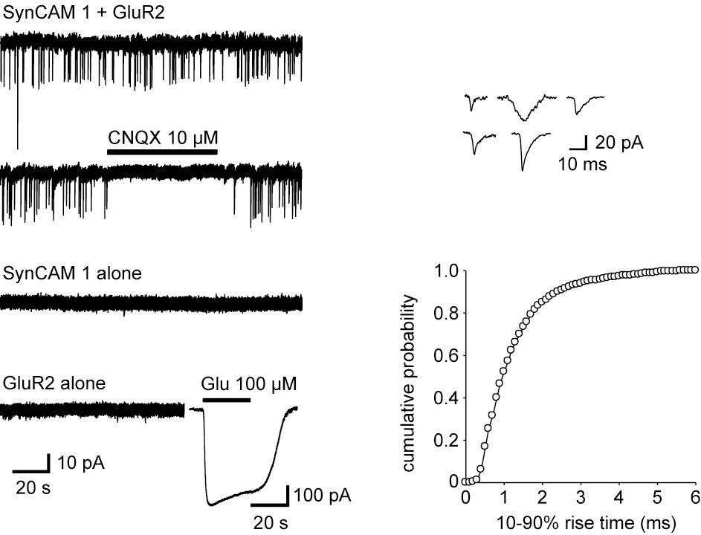
Reconstitution of Synaptic Transmission with SynCAM 1 and GluR2
Yildirim Sara and Ege Kavalali

Slide 13
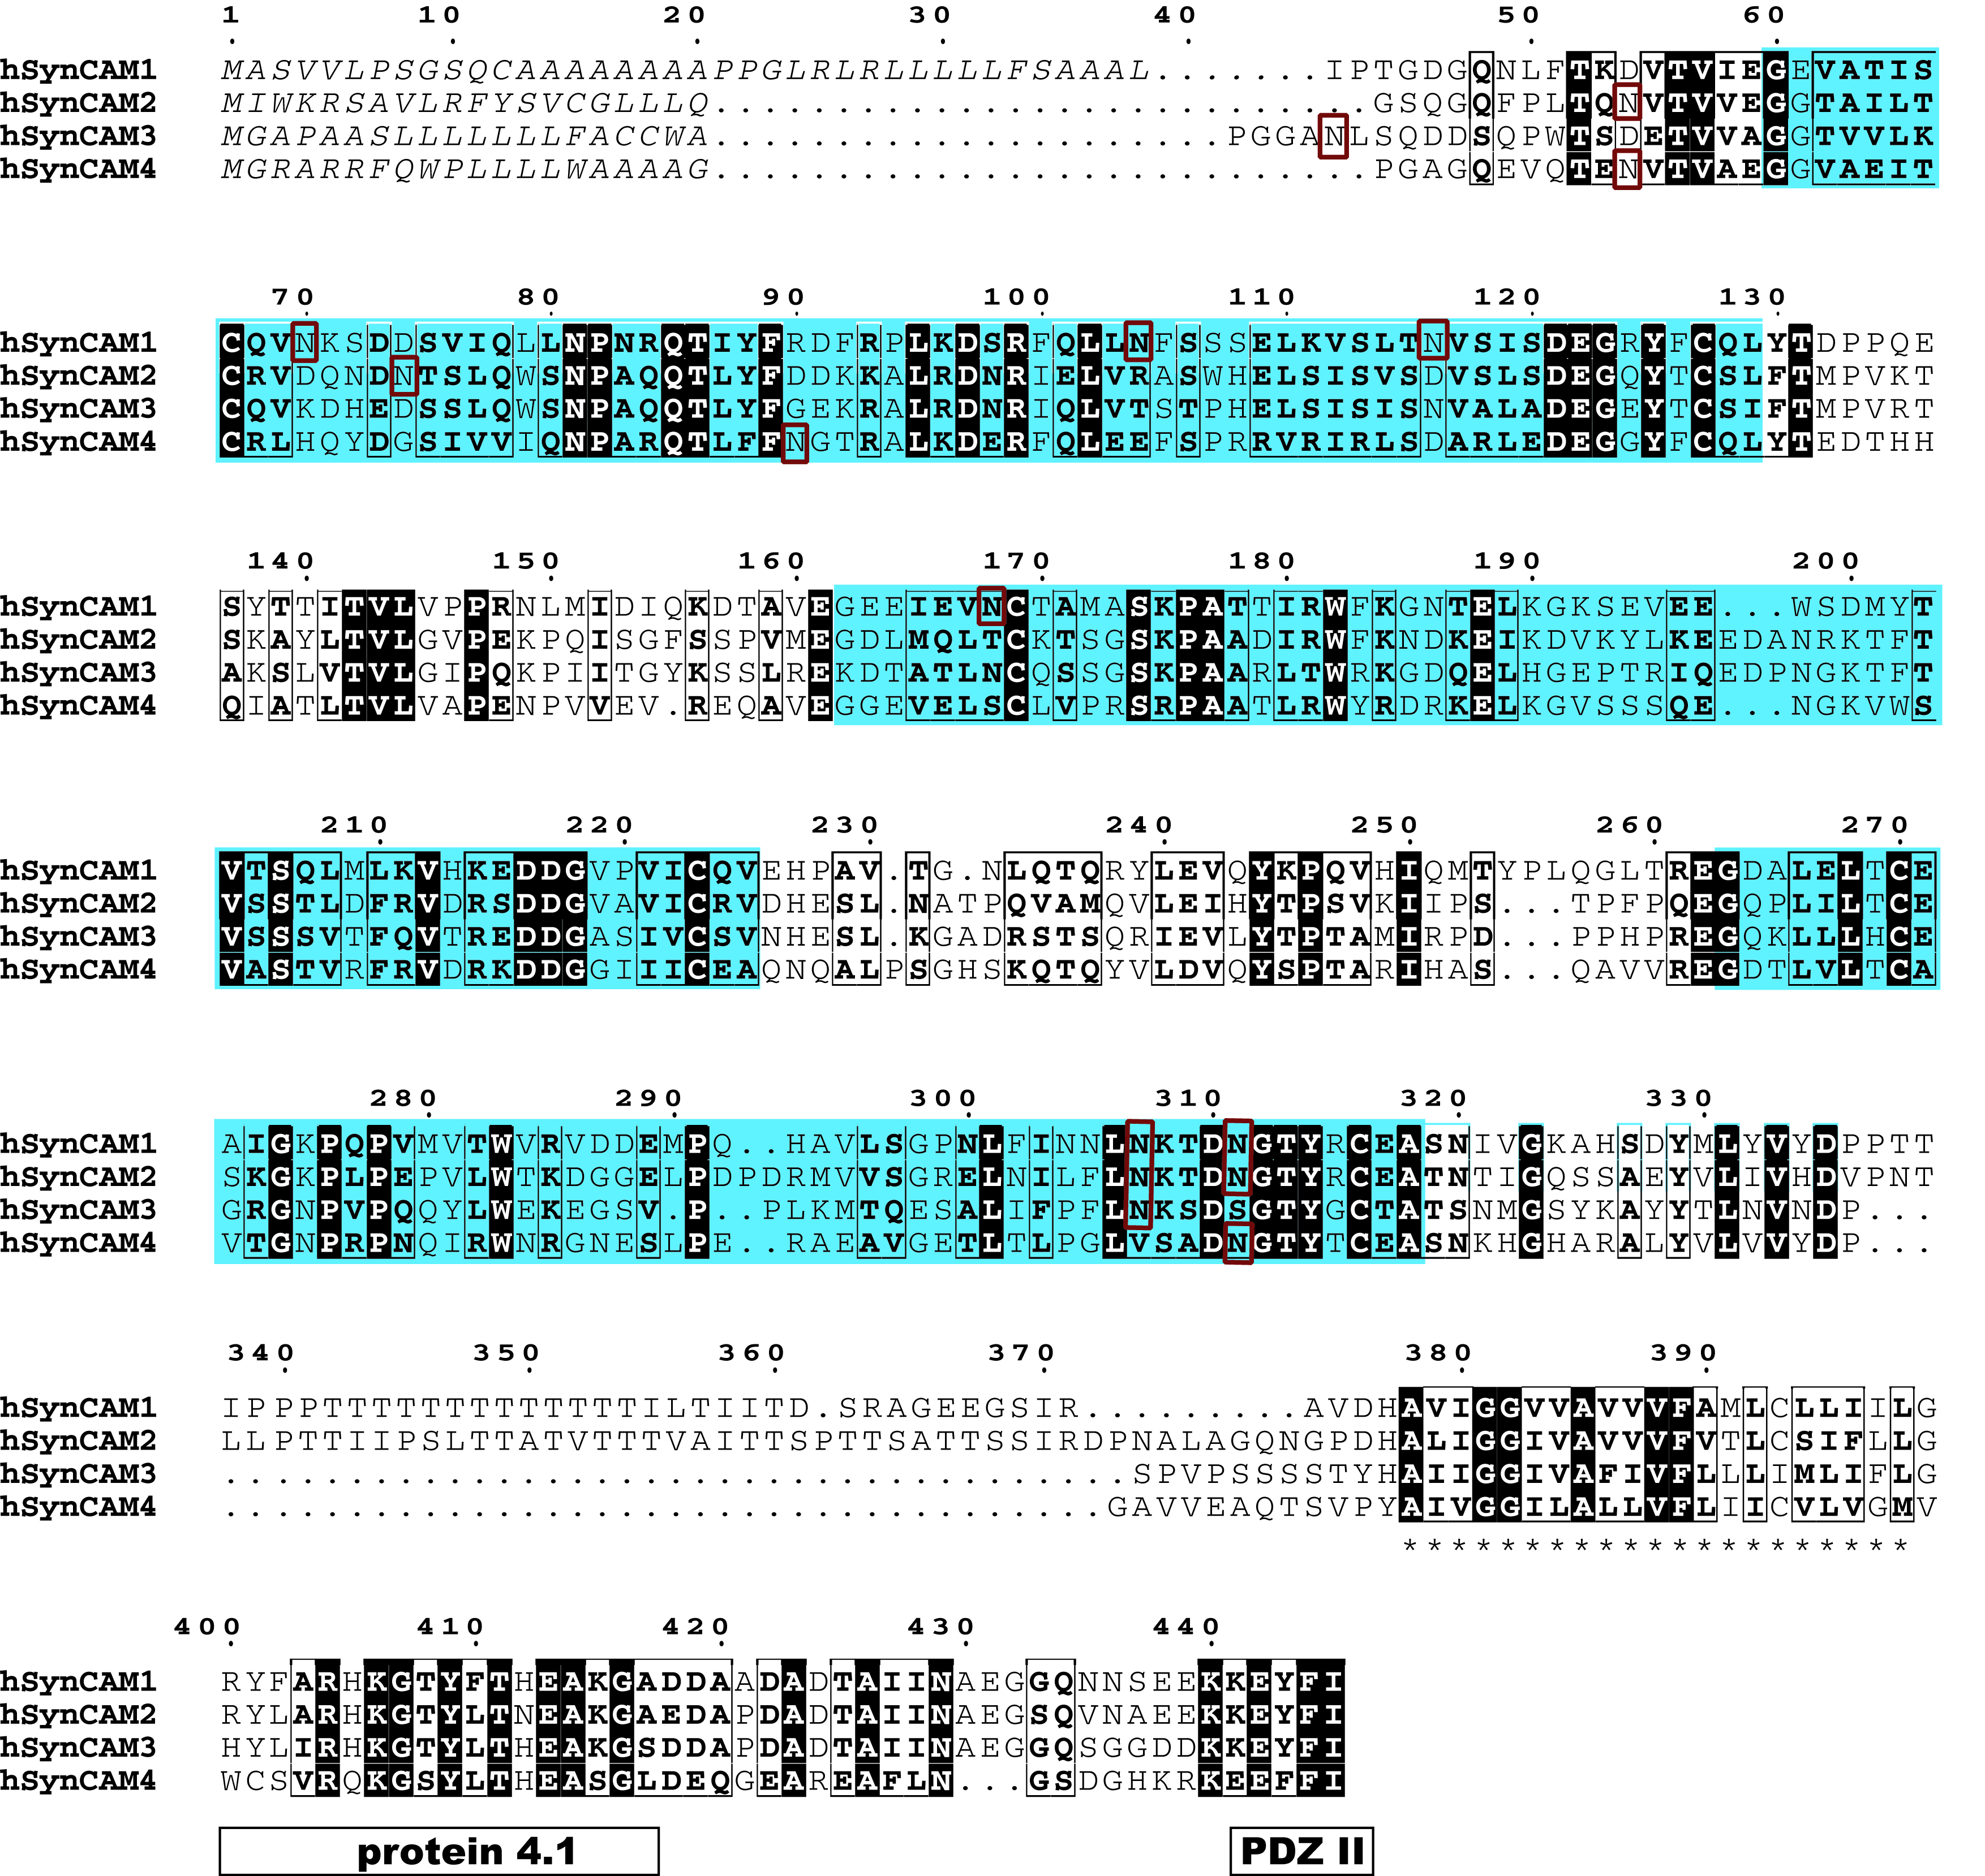
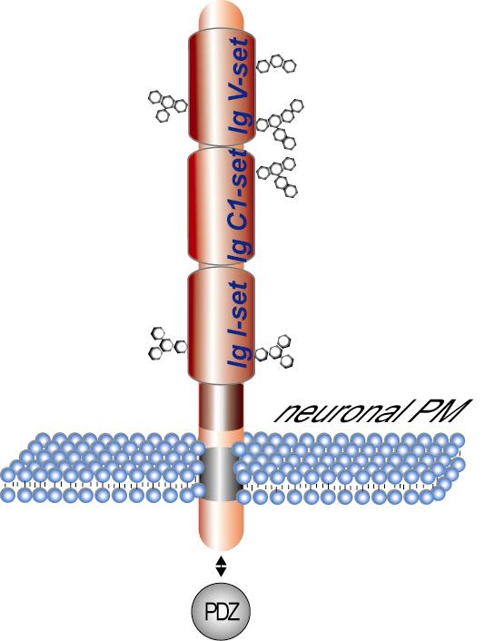
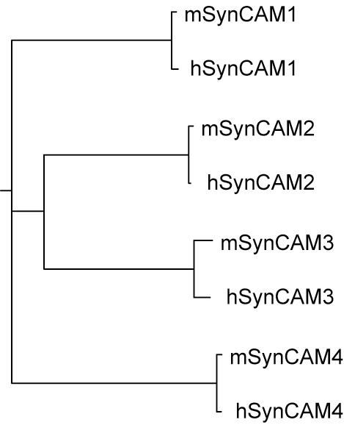
Sequence Alignment of SynCAM Family Members

Slide 14
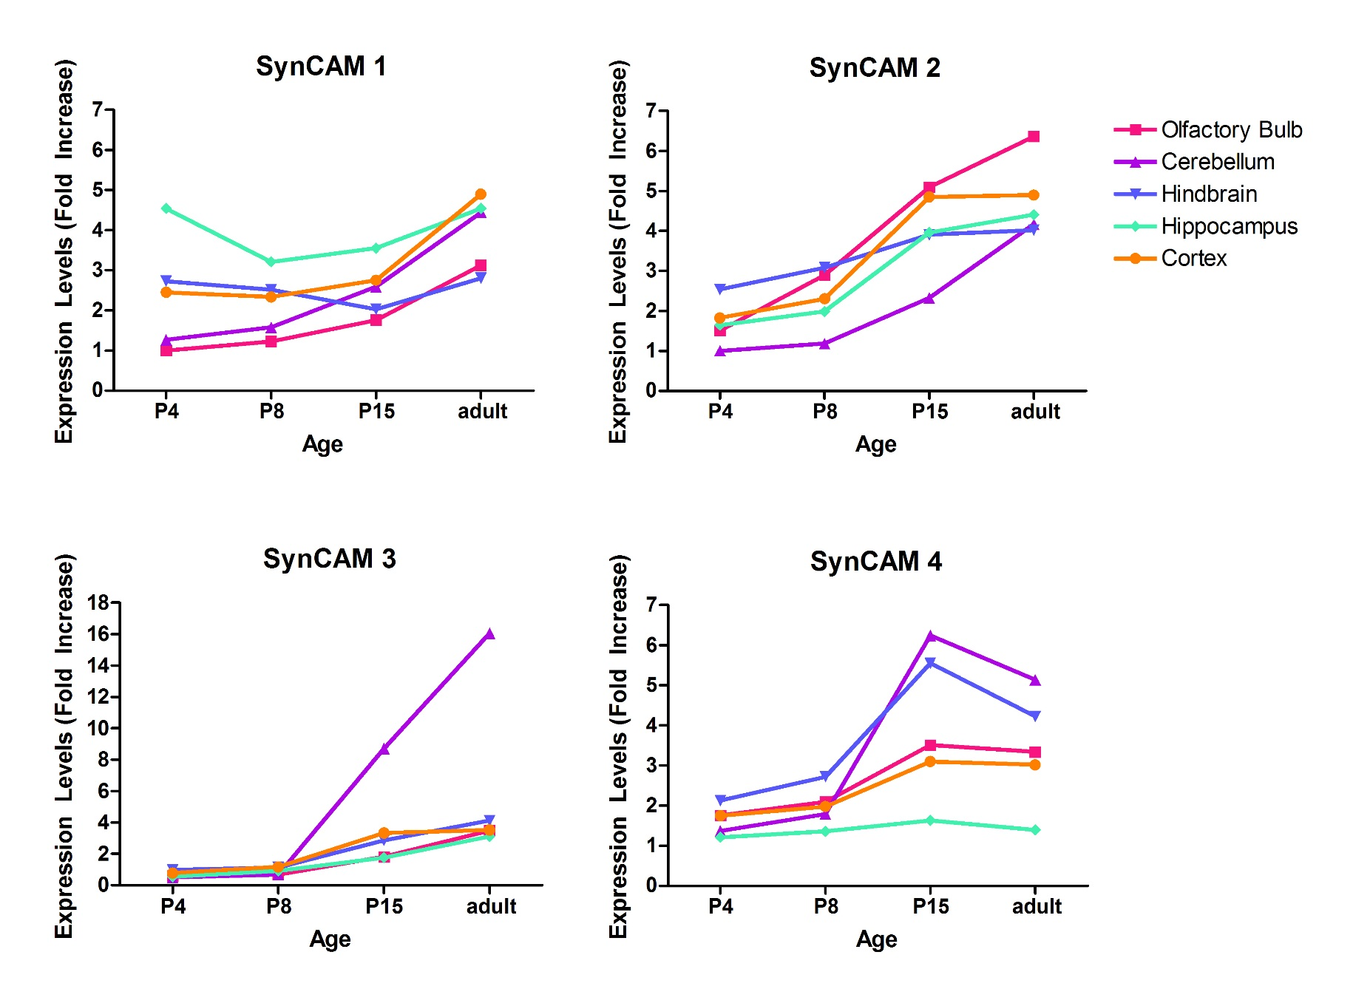
All Four SynCAM Family Members are Transcribed
in the Developing and Adult Brain
real-time
RT-PCR
standardized to actin
Mike Akins

Slide 15
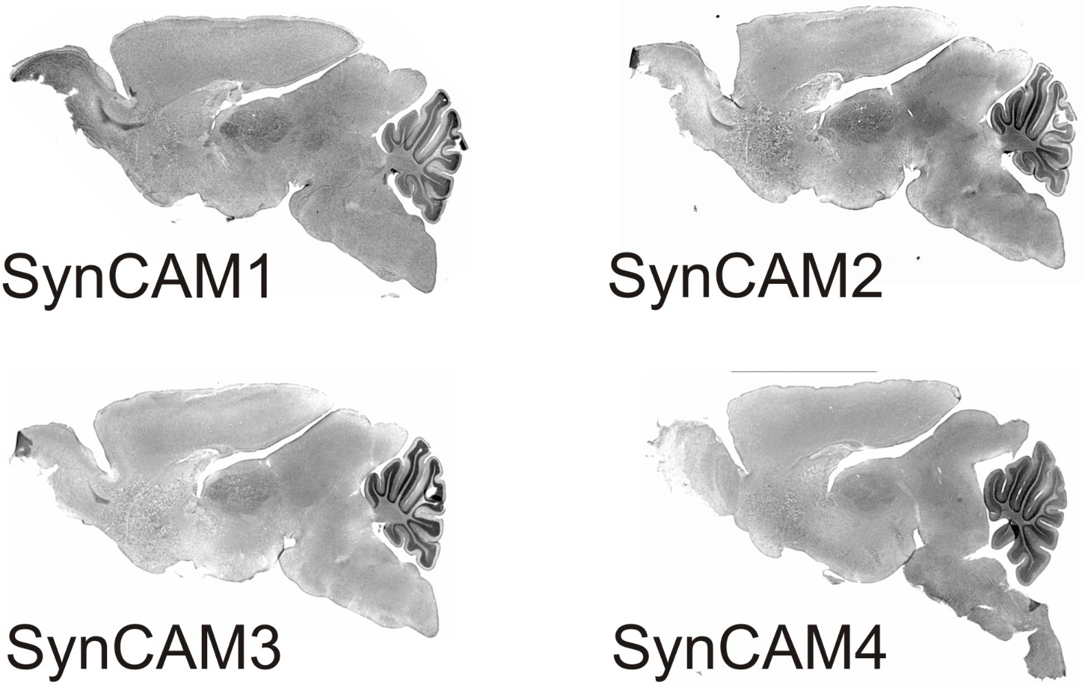
SynCAM Family Expression in Brain
in situ hybridizations at P15:
Mike Akins

Slide 16
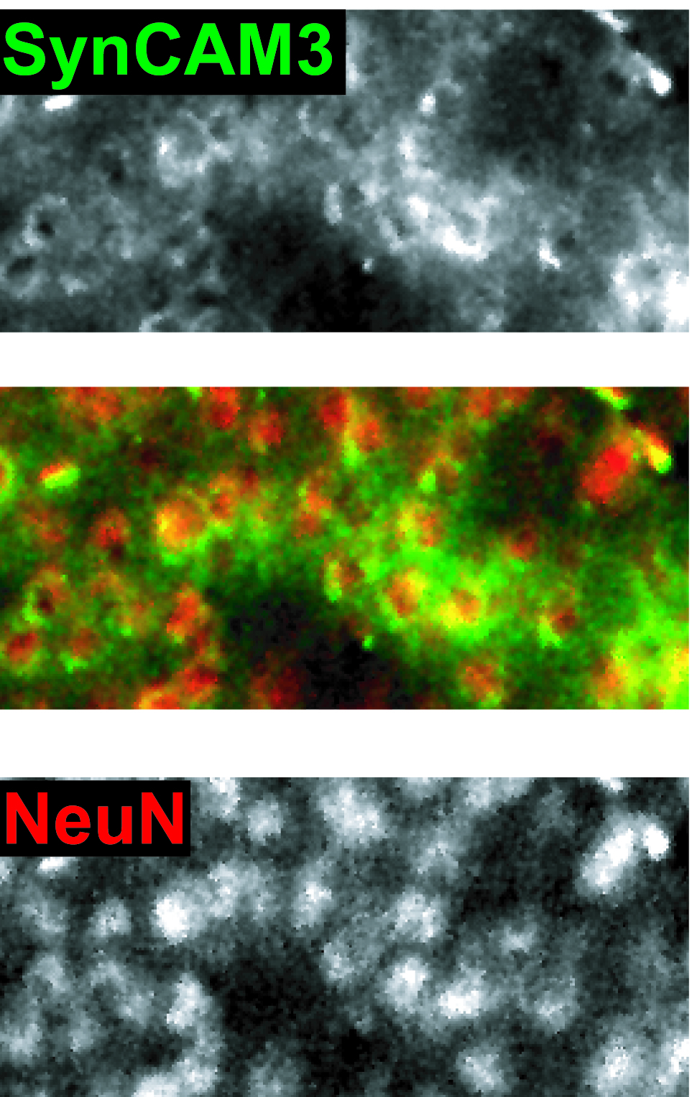
SynCAM Family Members are Expressed in Neurons
rat cortex
SynCAM 3 in situ hybridization
NeuN immunostaining
Mike Akins

Slide 17
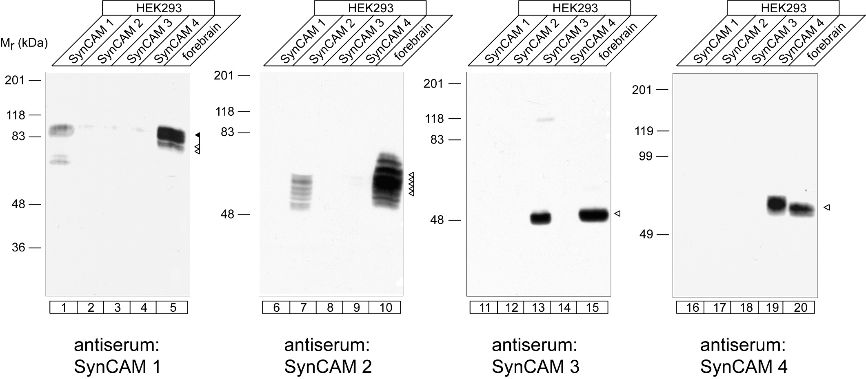
SynCAM Antibody Specificity
Adam Fogel

Slide 18
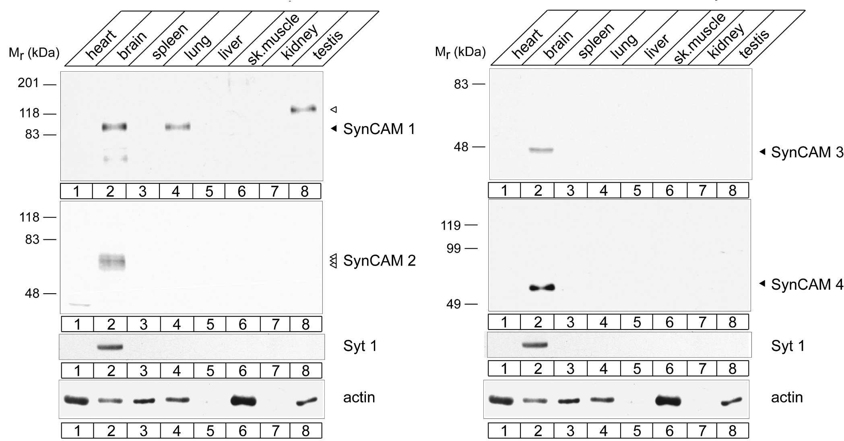
The Four SynCAM Proteins are Expressed in
Adult Brain
Adam Fogel

Slide 19
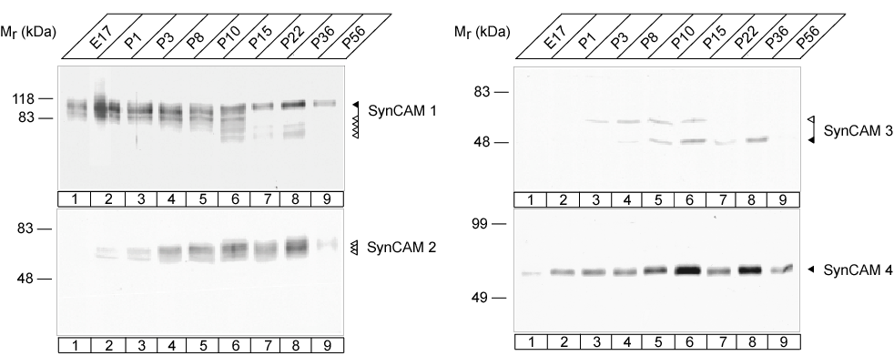
The Developmental Profile of SynCAM Proteins Correlates with Synaptogenesis
rat brain preparations:
Adam Fogel

Slide 20
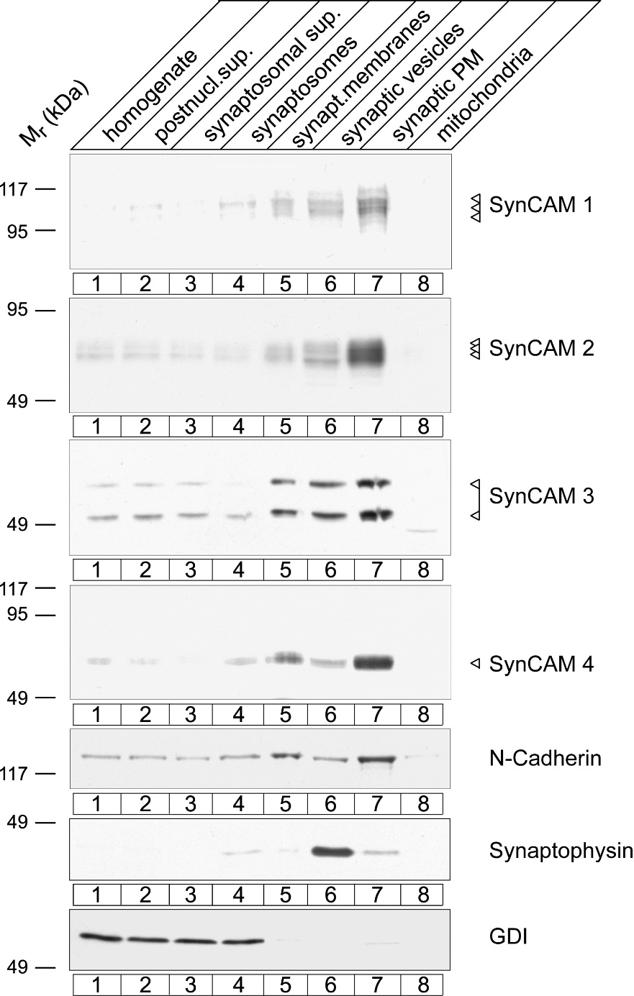
SynCAMs Fractionate as
Synaptic Plasma Membrane Proteins
rat forebrain P9

Slide 21
SynCAM Proteins are Prominent Components of
Synaptic Plasma Membranes
fraction of total SPM protein in P15 forebrain
SynCAM 1 ¹/180
SynCAM 2 ¹/300
SynCAM 3 ¹/1200
Adam Fogel

Slide 22
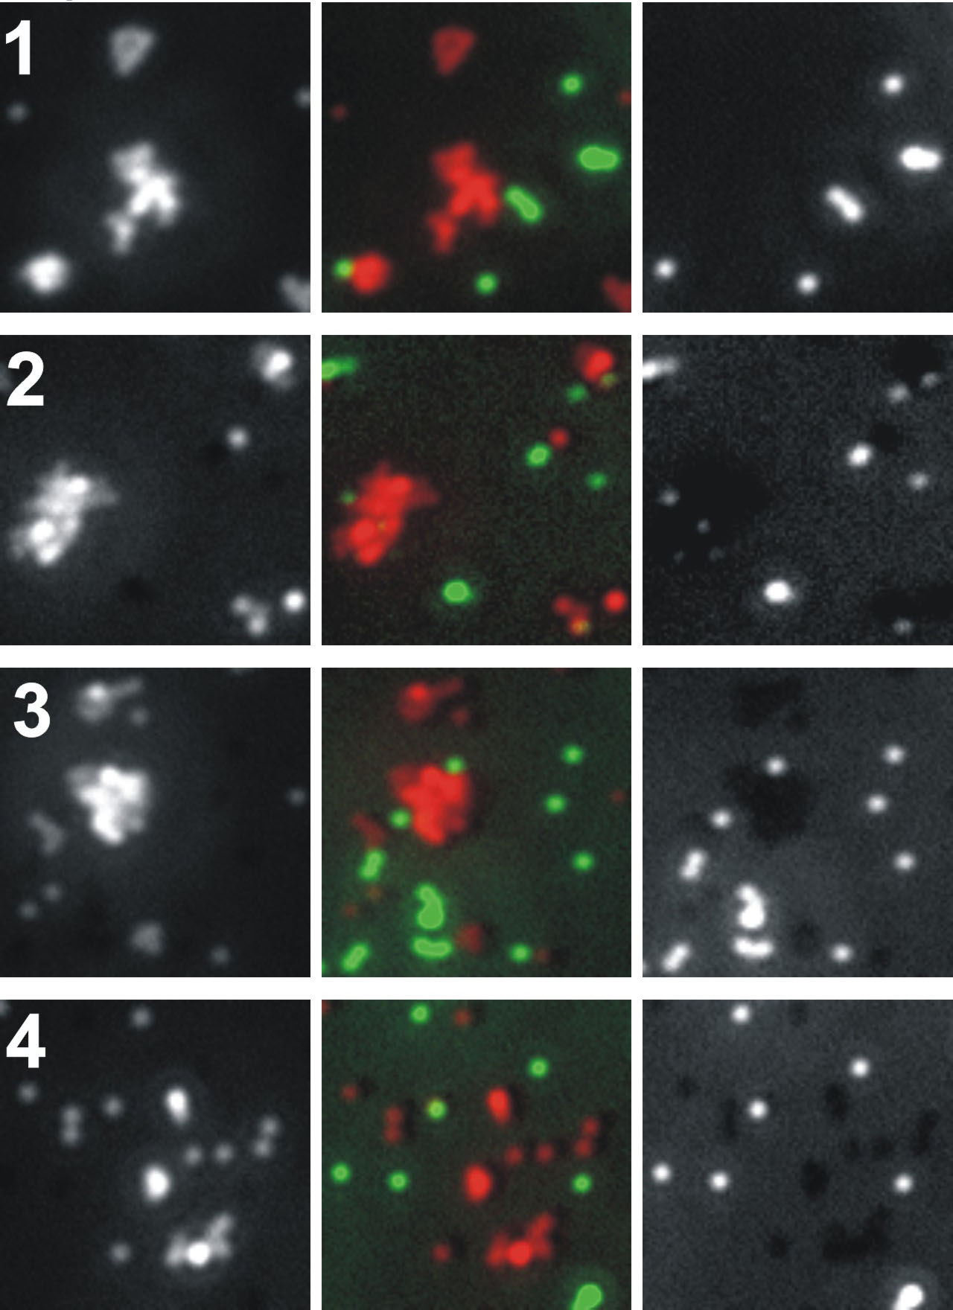
SynCAM Proteins Can Function as Homophilic
Adhesion Molecules
SynCAM 1, 2
and 3 interact homophilically
no evidence for string homophilic SynCAM 4 interactions
SynCAM-ECD
coated beads
control beads
Mike Akins

Slide 23
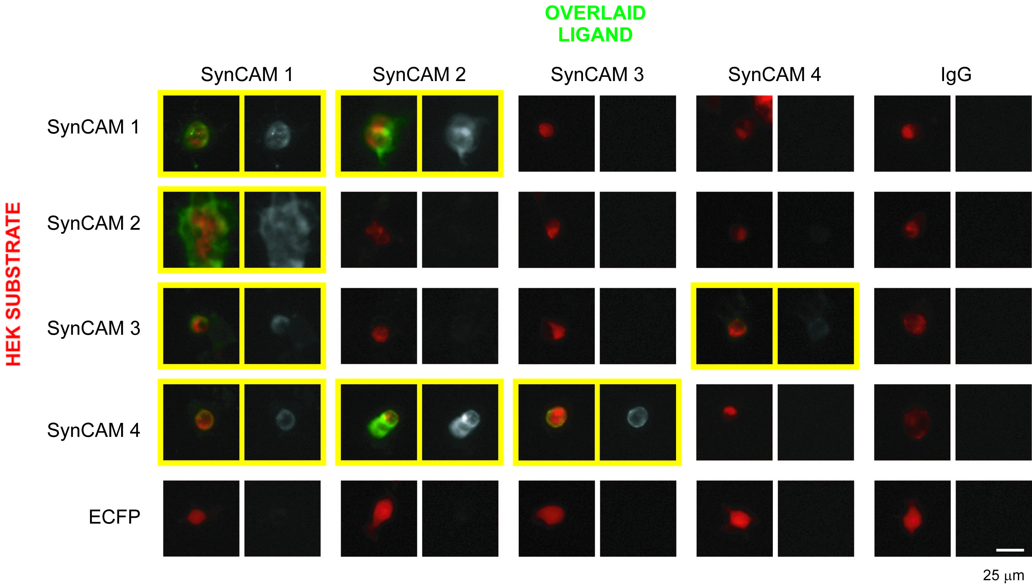
SynCAM Proteins Can Engage in Specific
Heterophilic Interactions
Mike Akins

Slide 24
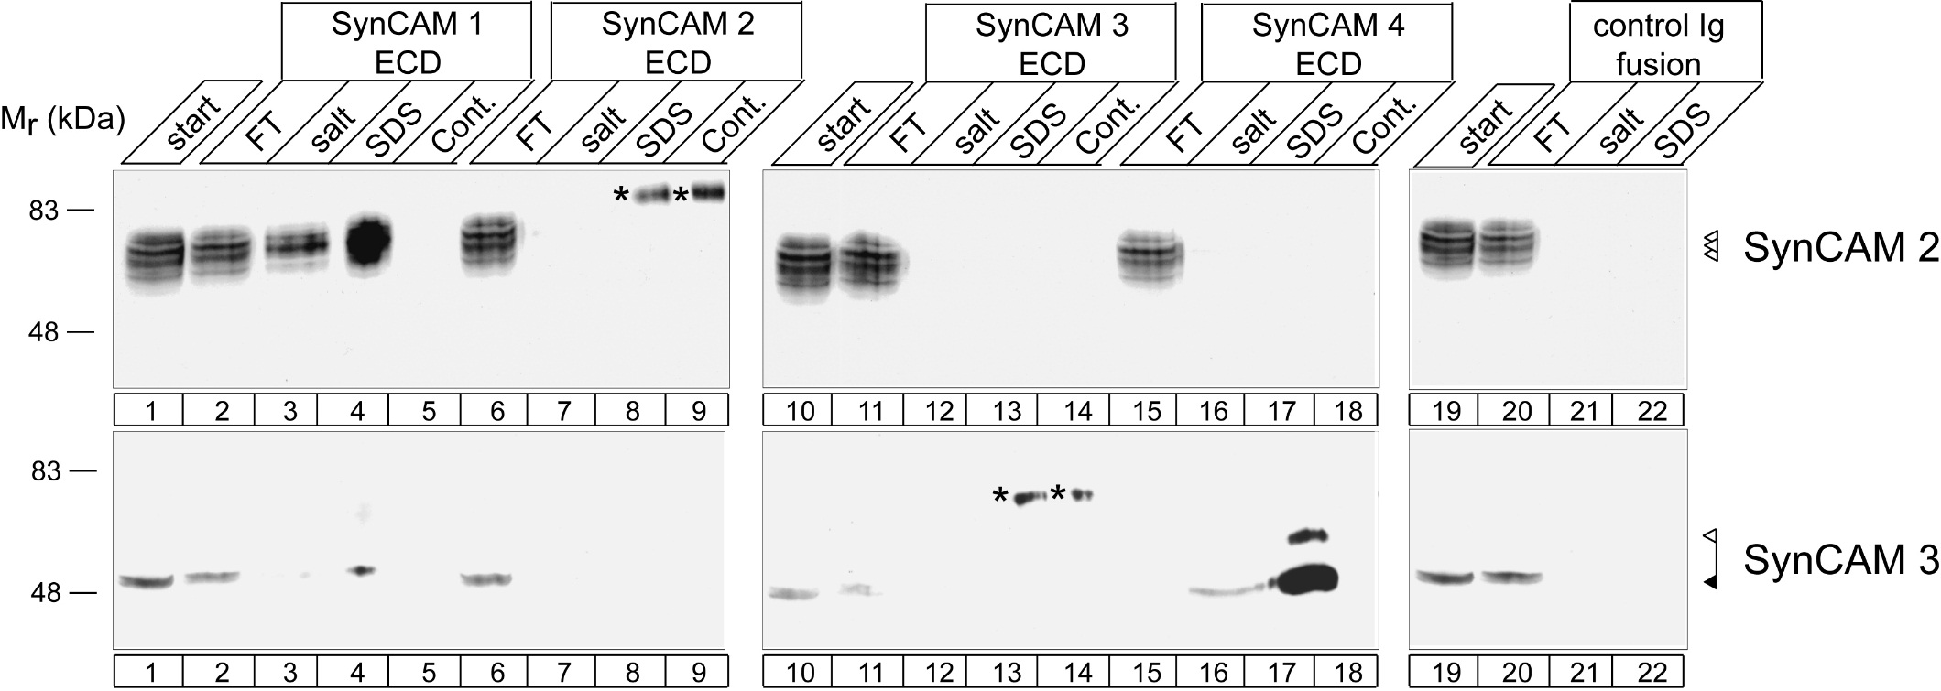
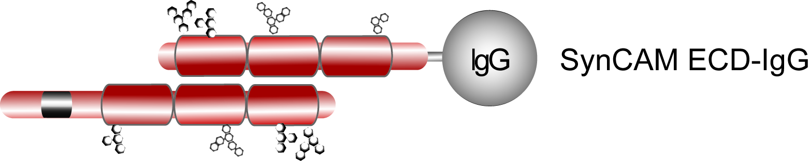
SynCAM Proteins Can Engage in Specific
Heterophilic Interactions
Adam Fogel

Slide 25
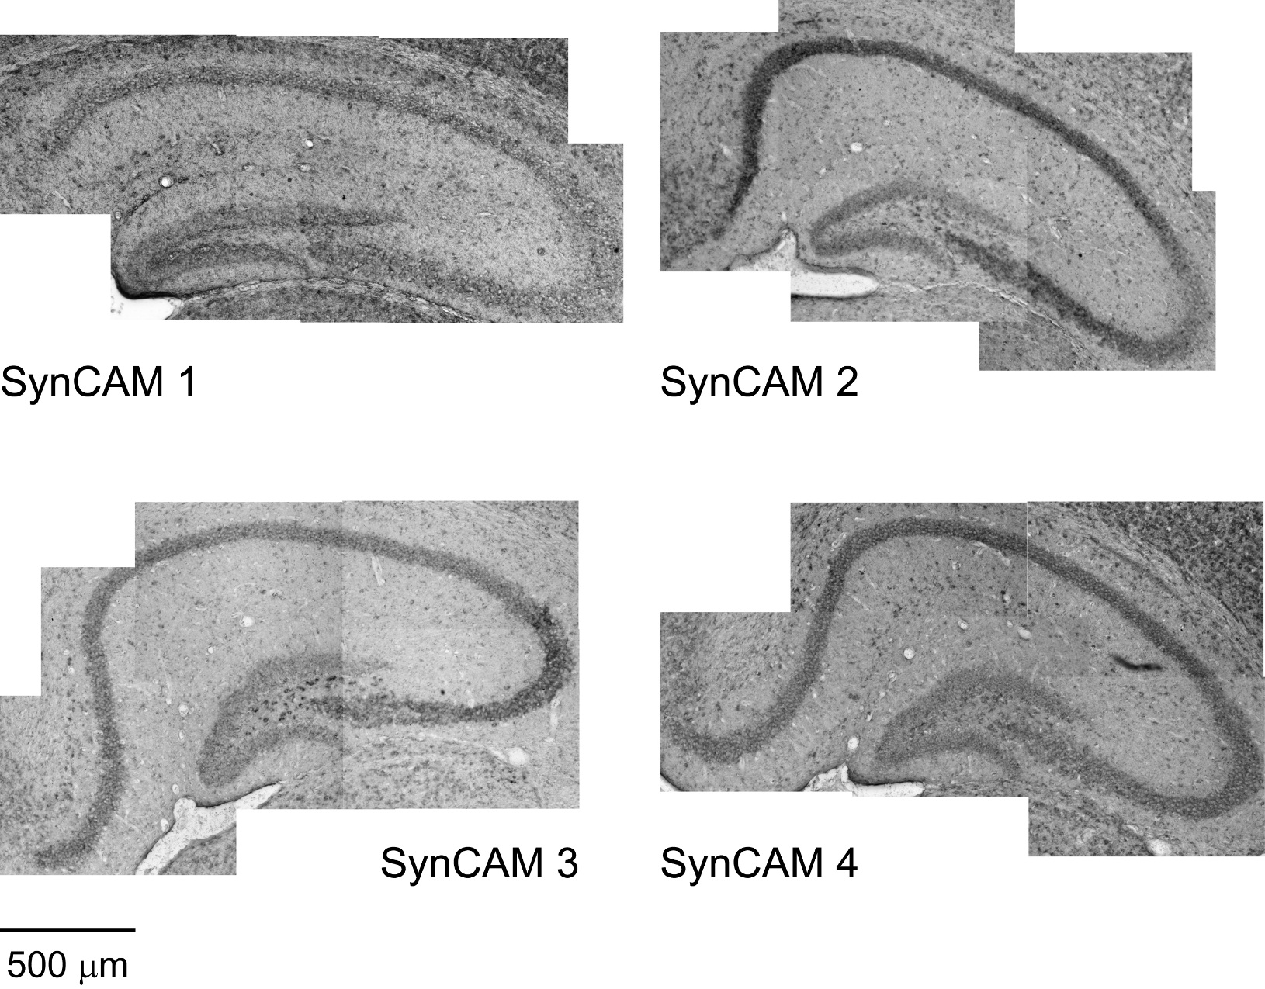
Distinct SynCAM Expression in Hippocampus
in situ hybridizations at P15:
Mike Akins

Slide 26
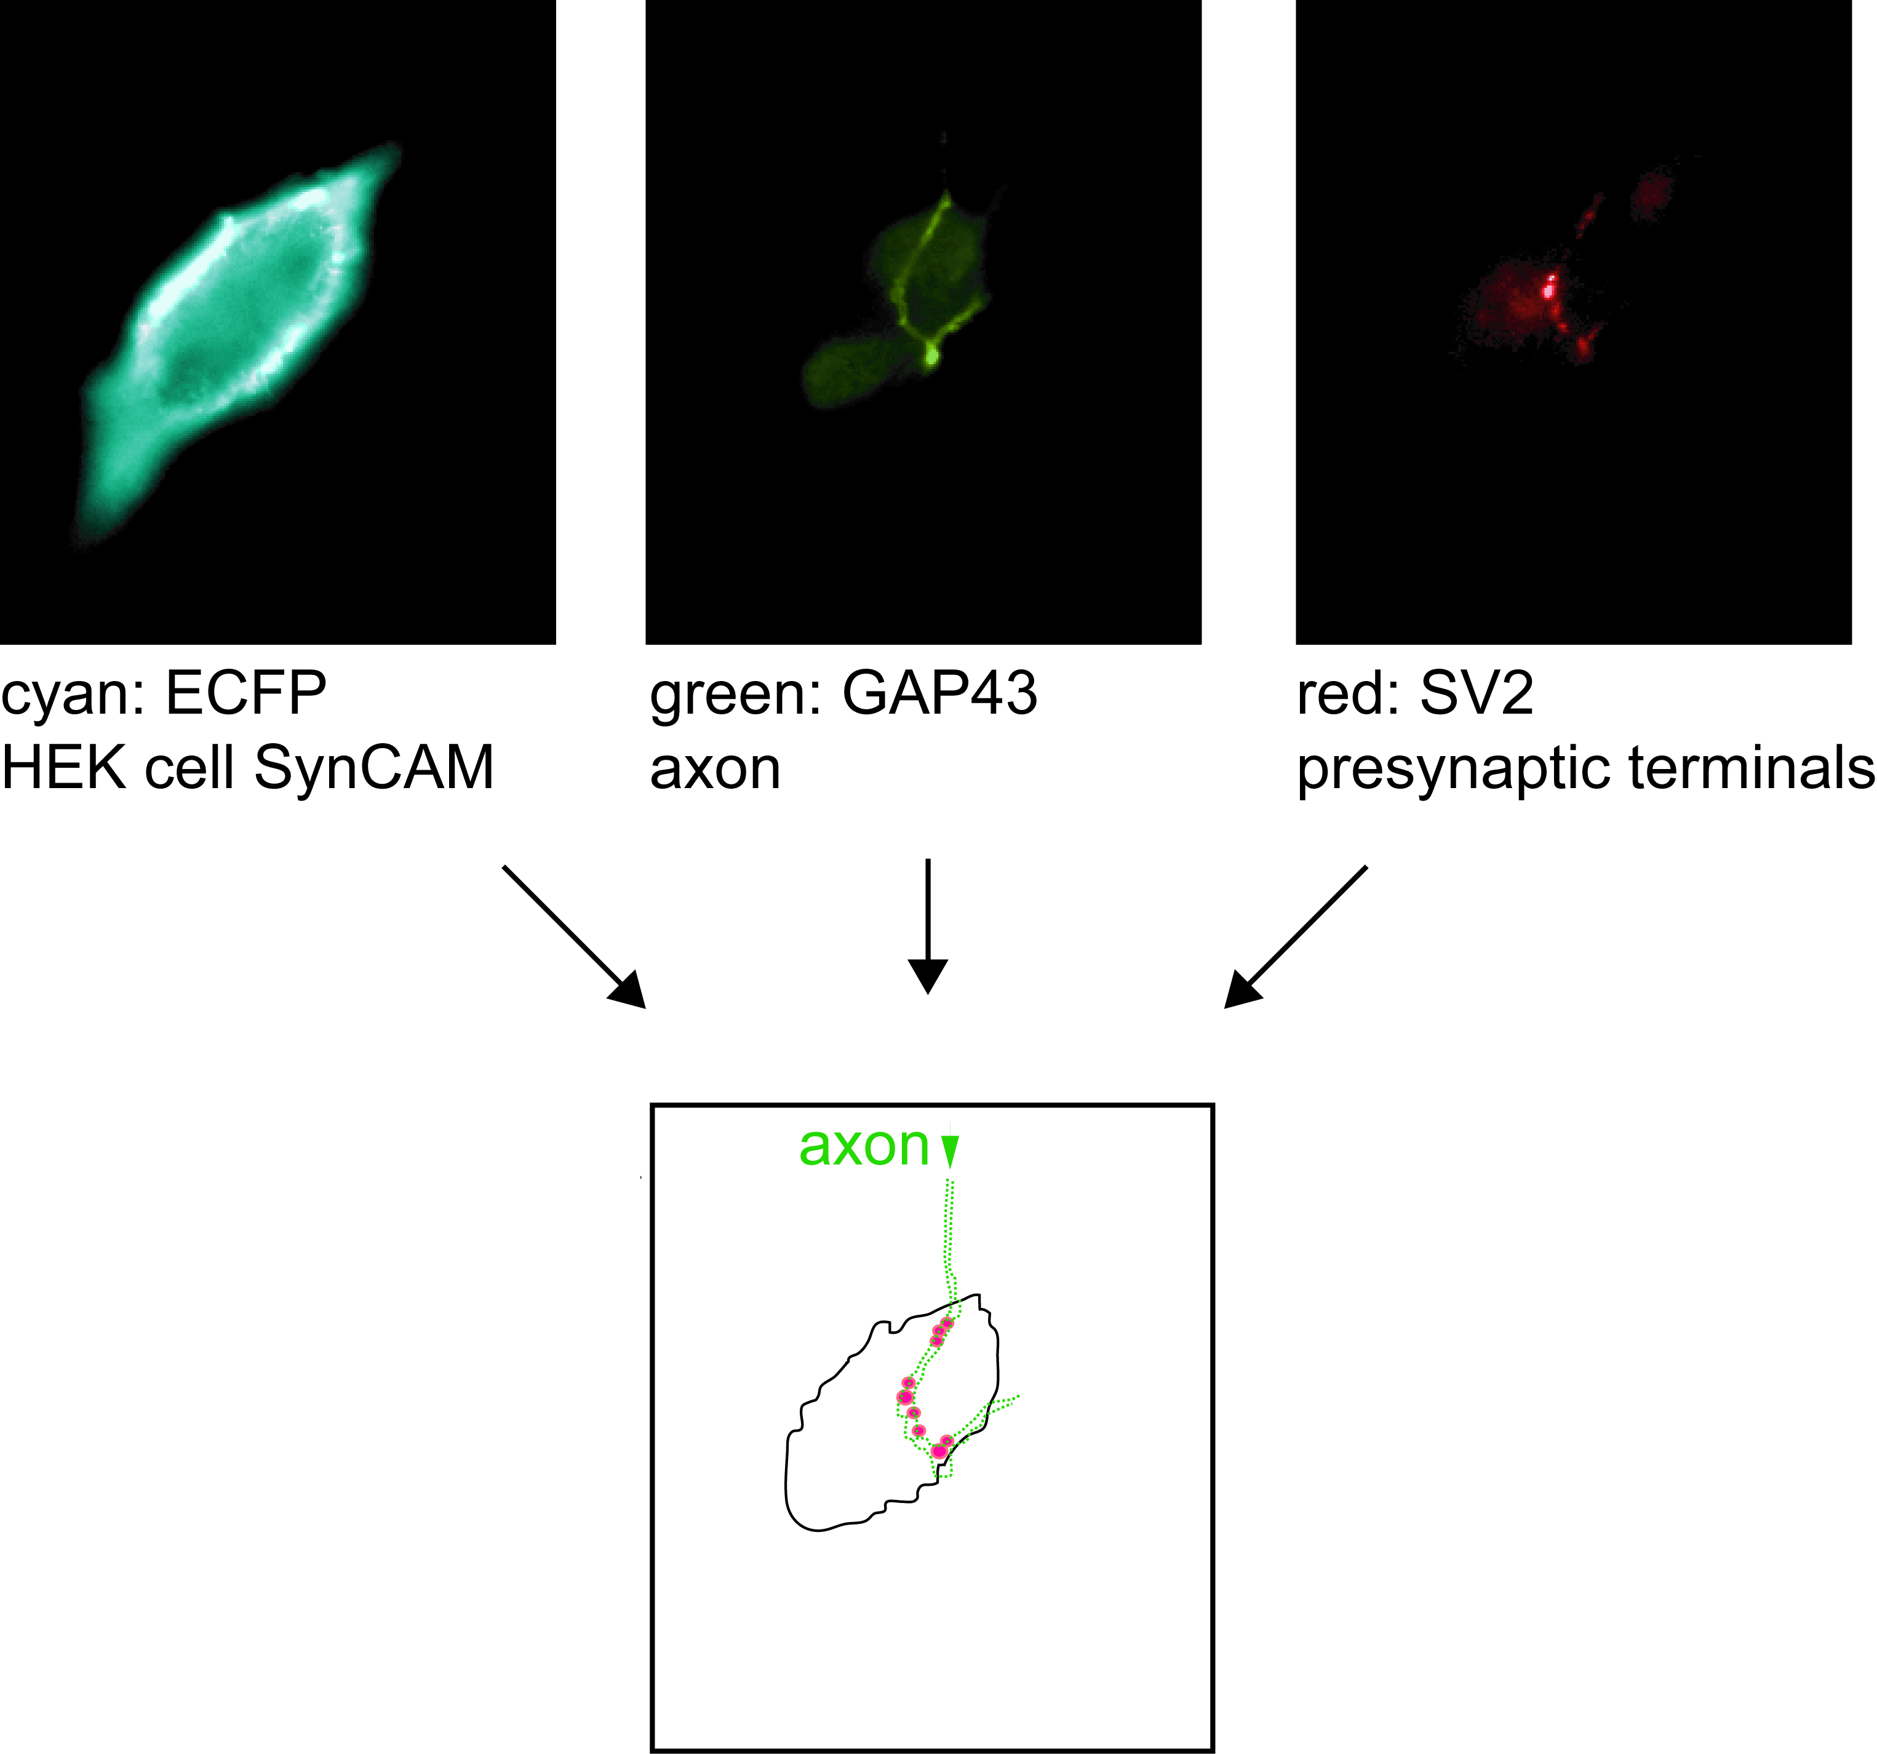
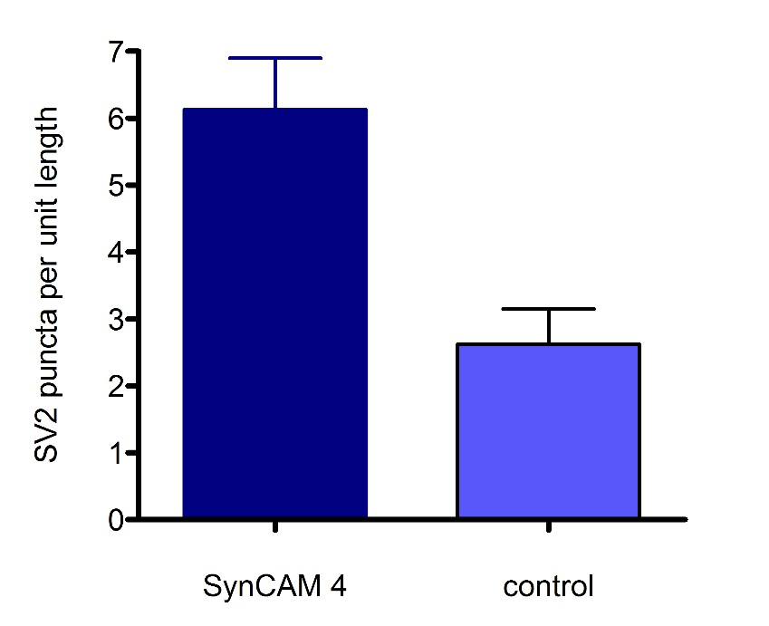
SynCAM 4 Induces Presynaptic Specializations
p < 0.01
**
Mike Akins

Slide 27
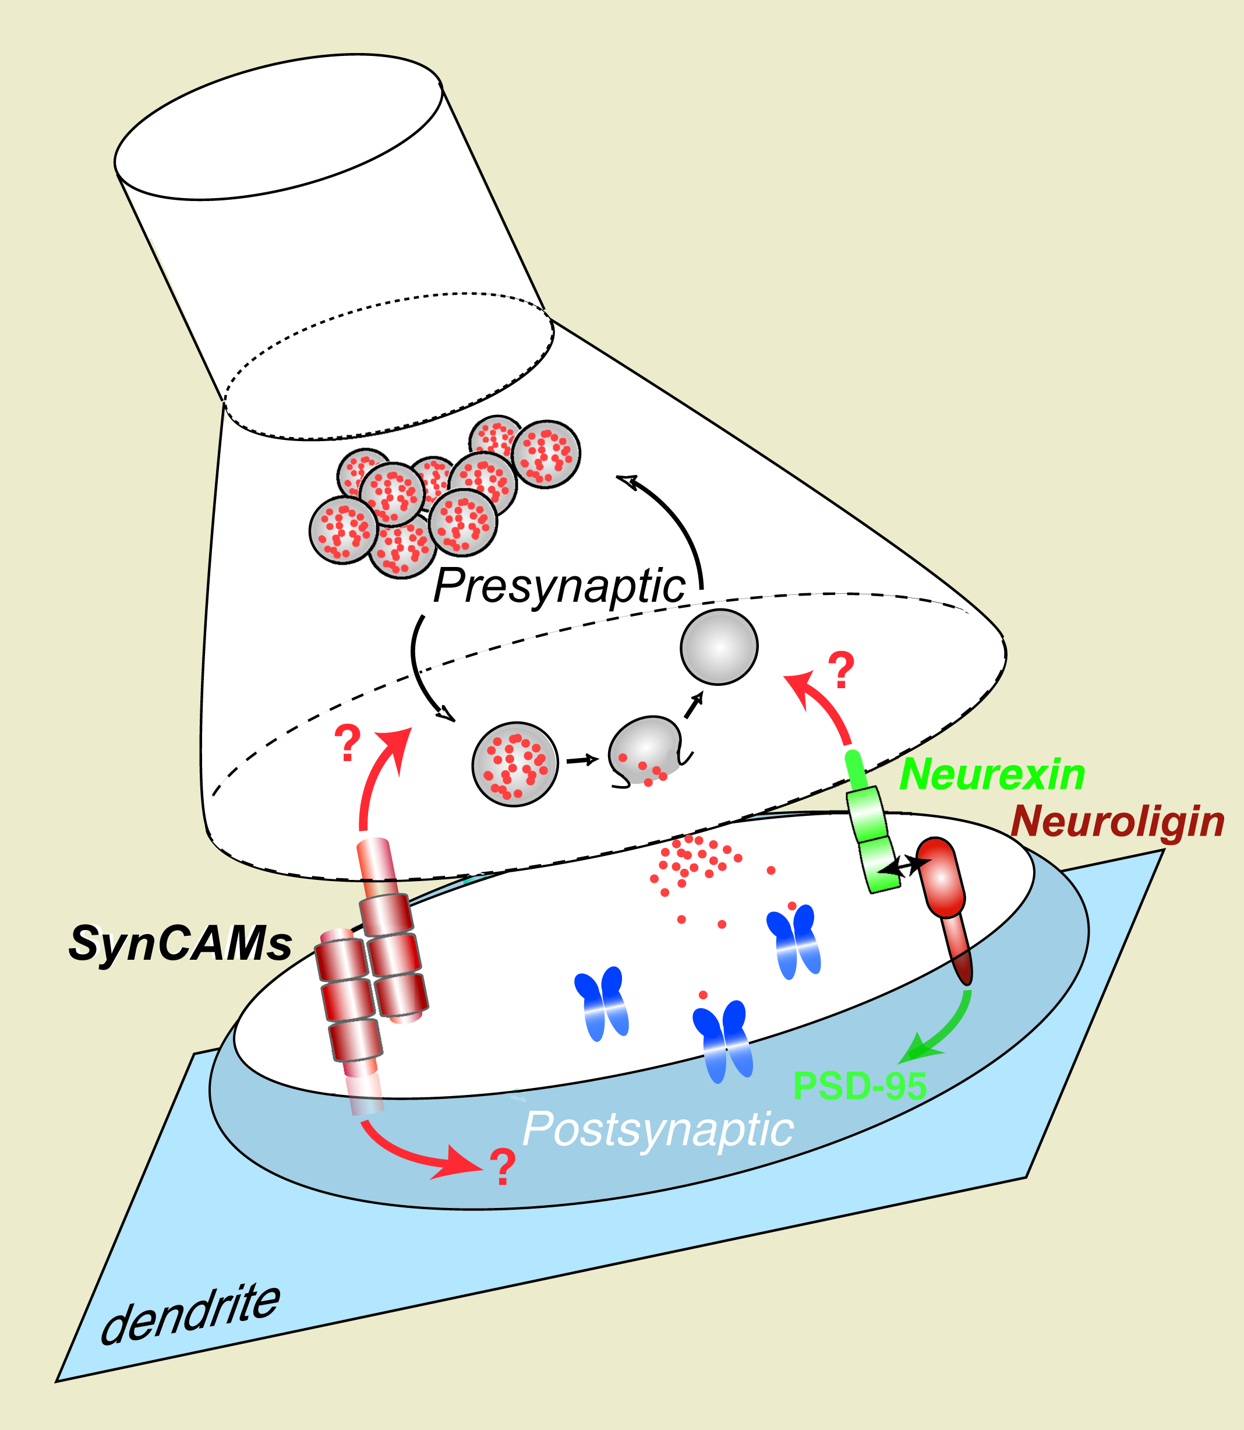
Synaptic Adhesion and Synaptogenesis: A Model

Slide 28
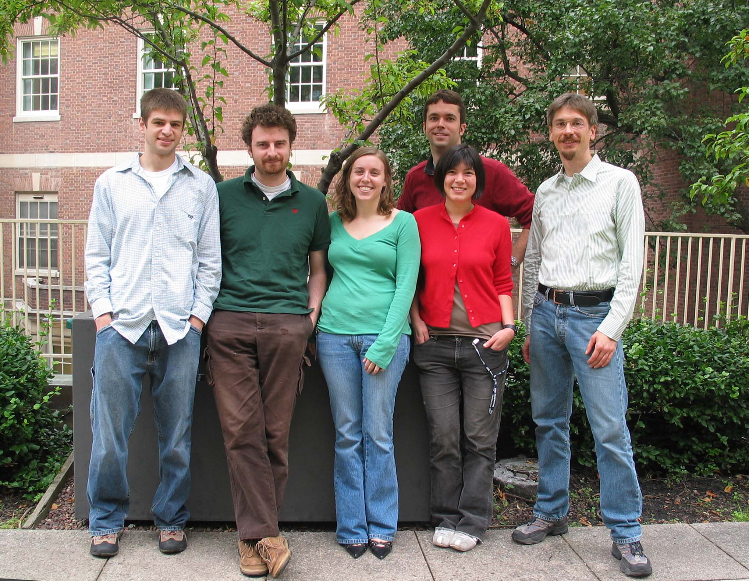




Acknowledgements
Mike Akins
Massimiliano Stagi
Adam Fogel
Elissa Robbins
Lisa Thomas
Yuling Lei
Ege T. Kavalali
Yildirim Sara
Thomas C. Südhof
Funding Support:
NIH/NIDA RO1 DA018928, March of Dimes Foundation and The Brain Tumor Society

